Slide 1

Log Analyis
By: Tyler Olson

Slide 2
Objectives
What is log analysis?
Application: Blue team
Viewing logs on a single host
Viewing logs on with a SIEM tool
Exercise: Phishing attack TryHackMe socsim

Slide 3
What are logs?
Logs are a way for organizations to maintain a record of what happened to a system
Essentially purchase receipts
Store location
Time of purchase
What was purchased
Type of payment

Slide 4
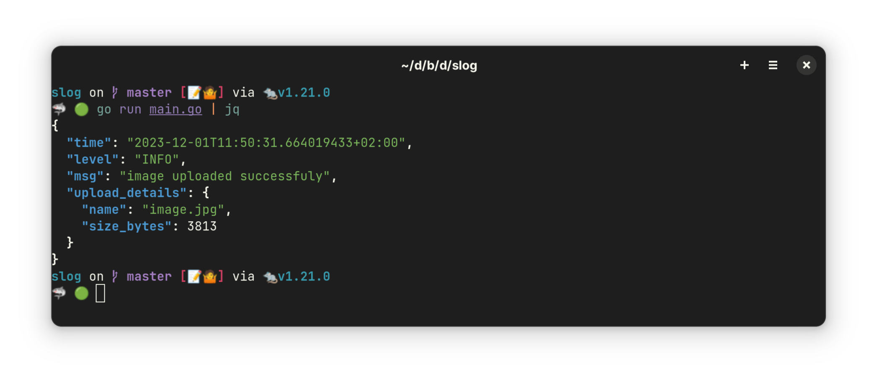
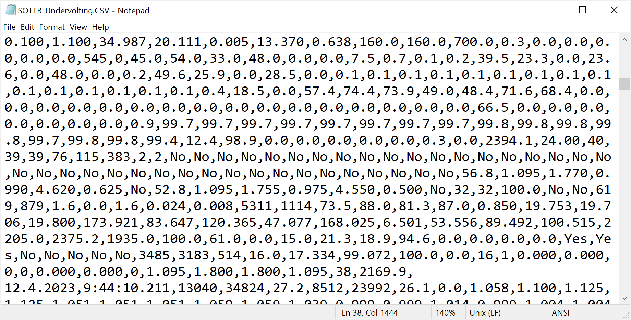
What are logs?
Come in two formats (Commonly):

Slide 5
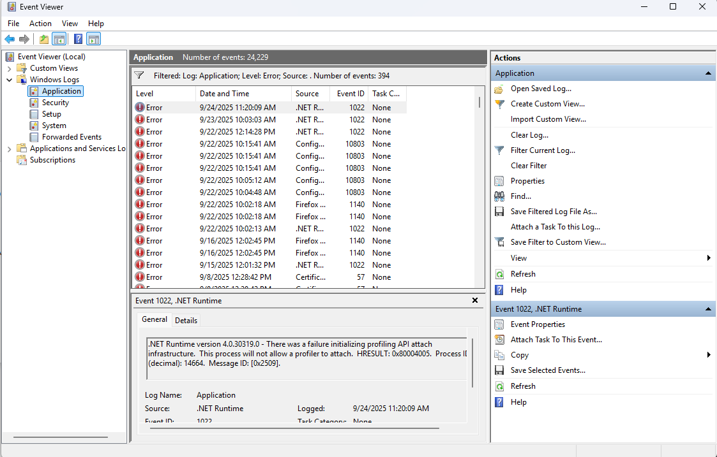
What about windows logs?
The dreaded Event Viewer
Propriety log format
Hard to parse unless using event viewer tool

Slide 6
What about windows logs? (Continued)
Take a look:
Windows key -> "Event Viewer" -> Enter

Slide 7
Log Analysis Checklist
Preplanning:
What am I looking for?
What is normal? (Baselining)
Tools
Text editor
Specialized log parser (event logs)
SIEM management tools
Note taking
Grab snippets, distill down.

Slide 8
Practical: Blue team application

Slide 9
Practical: Linux Web server logs
Linux logs: /var/log/apache2/access.log
Example in github logs/access.log
Example in github logs/auth.log

Slide 10
Practical: Windows Active Directory Logs
Requires specific diagnostic options enabled
Event viewer

Slide 11
Single host viewing is in efficient what do enterprises do?
Security Information Event Management (SIEM) tool
Hosts will forward logs to a main server using a "forwarder"
Logs parsed with SQL like-queries
One format for all hosts
Examples
Splunk
Logscale (CrowdStrike)
Elastic Search

Slide 12
Practical: Viewing logs on SPLUNK
Visit: splunk.abits.cloud
View your password sheet for login information

Slide 13
CTFs and Logs

Slide 14
Searching for text on linux
Using grep to find text
`cat access.log | grep 172.0.0.1`
`cat access.log | grep –e "success"`
`less access.log`
`head access.log`
`tail –f access.log`

Slide 15
Searching logs on windows
Right click view
"Filter current log"
Other tools might provide ability to search logs in other places

Slide 16
Putting it together

Slide 17
Putting it together: Logs and SOC analysts
Investigation tools
Assist with the facts finding
Who owns x machine

Slide 18
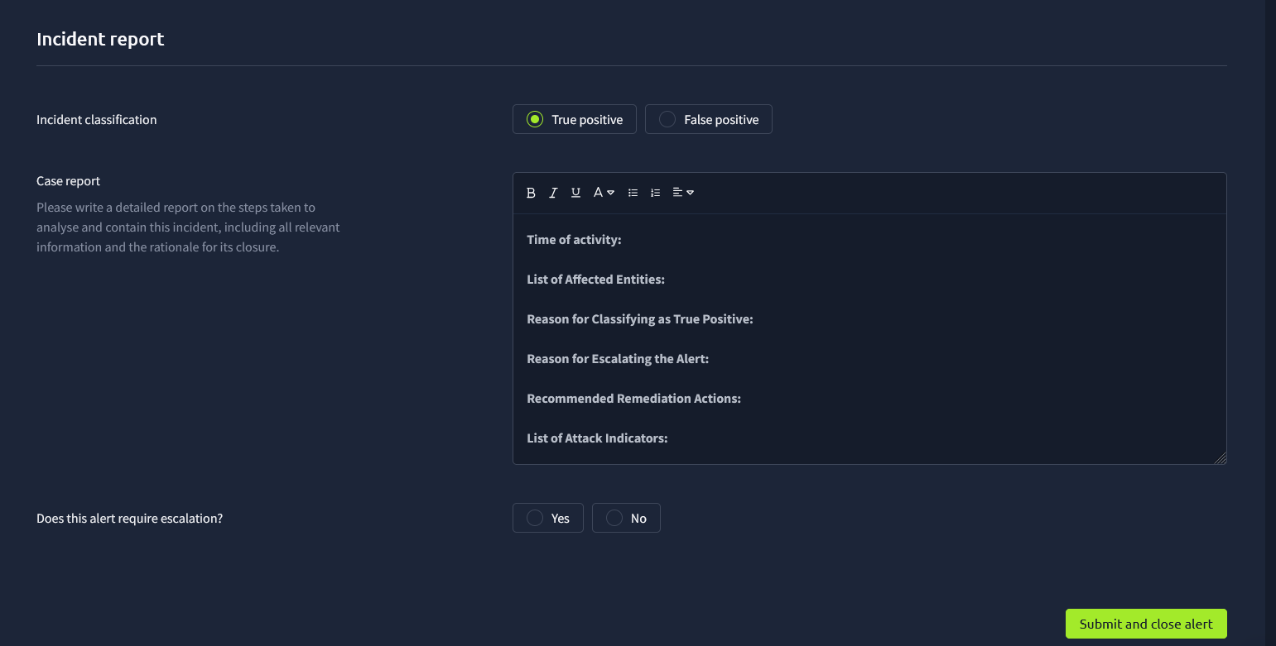

Slide 19
Putting it together: TryHackMe SOCsim
https://tryhackme.com/soc-sim/
Doing the phishing simulator together. Adding in about SOC analysts

Slide 20
National Cyber League

Slide 21
What is National Cyber League
Capture the flag available to students happens once each semester.
Great tool to help learn about cybersecurity and show applied skills
Helpful tutorials on challenges
Great community behind it
$45 registration fee

